Slide 1
UCSMSDK Cisco Ucs Python SDK

Slide 2
Agenda
What is ucsmsdk?
How to install it?
How to learn to use it?
Login/Logout
CRUD operations
Transaction support
convert_to_ucs_python
Sample scripts and Documentation
Where to go for help?
Q&A

Slide 3
ucsmsdk
Python modules for Cisco UCS Servers
Performs CRUD operations
Python APIs are automatically generated based off XML Schema
Free to download from Python Package Index(pypi)
Follows python best practices and PEP8 compliance

Slide 4
What can the ucsmsdk control?
Hardware
VLANs, LAN Uplink, SAN Uplink, Server, Appliance Ports, Port Channels, etc.
Pools
Servers, UUID, MAC, IP, WWPN, WWNN, iSCSI, etc.
Policies
BIOS, Firmware, Adapters, Boot, Drives, etc.
Templates
vNIC, vHBA, Service Profile Templates, etc.
Reporting
vNIC Statistics, vHBA Statistics, Thermal, Resources, etc.

Slide 5
Installation
Last stable version from Python Package Index (pypi)
pip install ucsmsdk
Latest development version from Github
git clone https://github.com/ciscoucs/ucsmsdk
cd ucsmsdk
sudo make install

Slide 6
Why?
Configure a UCS domain in just a few minutes
Once you have the configuration it becomes repeatable and so consistent. Same results 100% of the times
Configurations are much faster and can be done in parallel - configure N domains in parallel.

Slide 7
Login/Logout
from ucsmsdk.ucshandle import UcsHandle
# Create a connection handle
handle = UcsHandle("192.168.1.1", "admin", "password")
# Login to the server
handle.login()
# Logout from the server
handle.logout()

Slide 8
CRUD operations
Below are some of the APIs that facilitate CRUD operations on Managed Objects exposed by Cisco UCS Servers
Create an object - add_mo
Retrieve an object - query_dn
query_classid
query_dns
query_classids
Update an object - set_mo
Delete an object - delete_mo

Slide 9
Creating an Object
from ucsmsdk.mometa.ls.LsServer import LsServer
# Create a Service Profile Object
sp = LsServer(parent_mo_or_dn="org-root", name="sp_demo")
# Add the create Mo to a transaction
handle.add_mo(sp)
# Commit the transaction
handle.commit()

Slide 10
Updating an Object
# Query for an existing Mo
sp = handle.query_dn("org-root/ls-sp_demo")
# Update description of the service profile
sp.descr = "demo_descr"
# Add it to the on-going transaction
handle.set_mo(sp)
# commit the changes
handle.commit()

Slide 11
Deleting an object
# Query for an existing Mo
sp = handle.query_dn("org-root/ls-sp_demo")
# Remove the object
handle.remove_mo(sp)
# commit the changes
handle.commit()

Slide 12
Transaction
All or None - If a step in the transaction fails, no changes are applied to the server
from ucsmsdk.mometa.ls.LsServer import LsServer
# Create Service Profile sp_demo1 and add it to transaction
sp1 = LsServer(parent_mo_or_dn="org-root", name="sp_demo1")
handle.add_mo(sp1)
# Create Service Profile sp_demo2 and add it to transaction
sp2 = LsServer(parent_mo_or_dn="org-root", name="sp_demo2") handle.add_mo(sp2)
# commit the changes to server
# Both the Service profiles are created at this point
handle.commit()

Slide 13
convert_to_ucs_python
Automate generating python code based off operations done on the UCSM GUI.
Step#1 – Launch UCSM GUI from python shell!
from ucsmsdk.utils.ucsguilaunch import ucs_gui_launch
from ucsmsdk.ucshandle import UcsHandle
# Login to the server
handle = UcsHandle(<ip>, <username>, <password>)
handle.login()
# launch the UCSM GUI
ucs_gui_launch(handle)

Slide 14
convert_to_ucs_python
Step#2 - Run convert_to_ucs_python
from ucsmsdk.utils.converttopython import convert_to_ucs_python
# The CLI will go into a listen mode until Ctrl+C is pressed again. Until then it prints equivalent script for operations done on the UI.
convert_to_ucs_python()

Slide 15
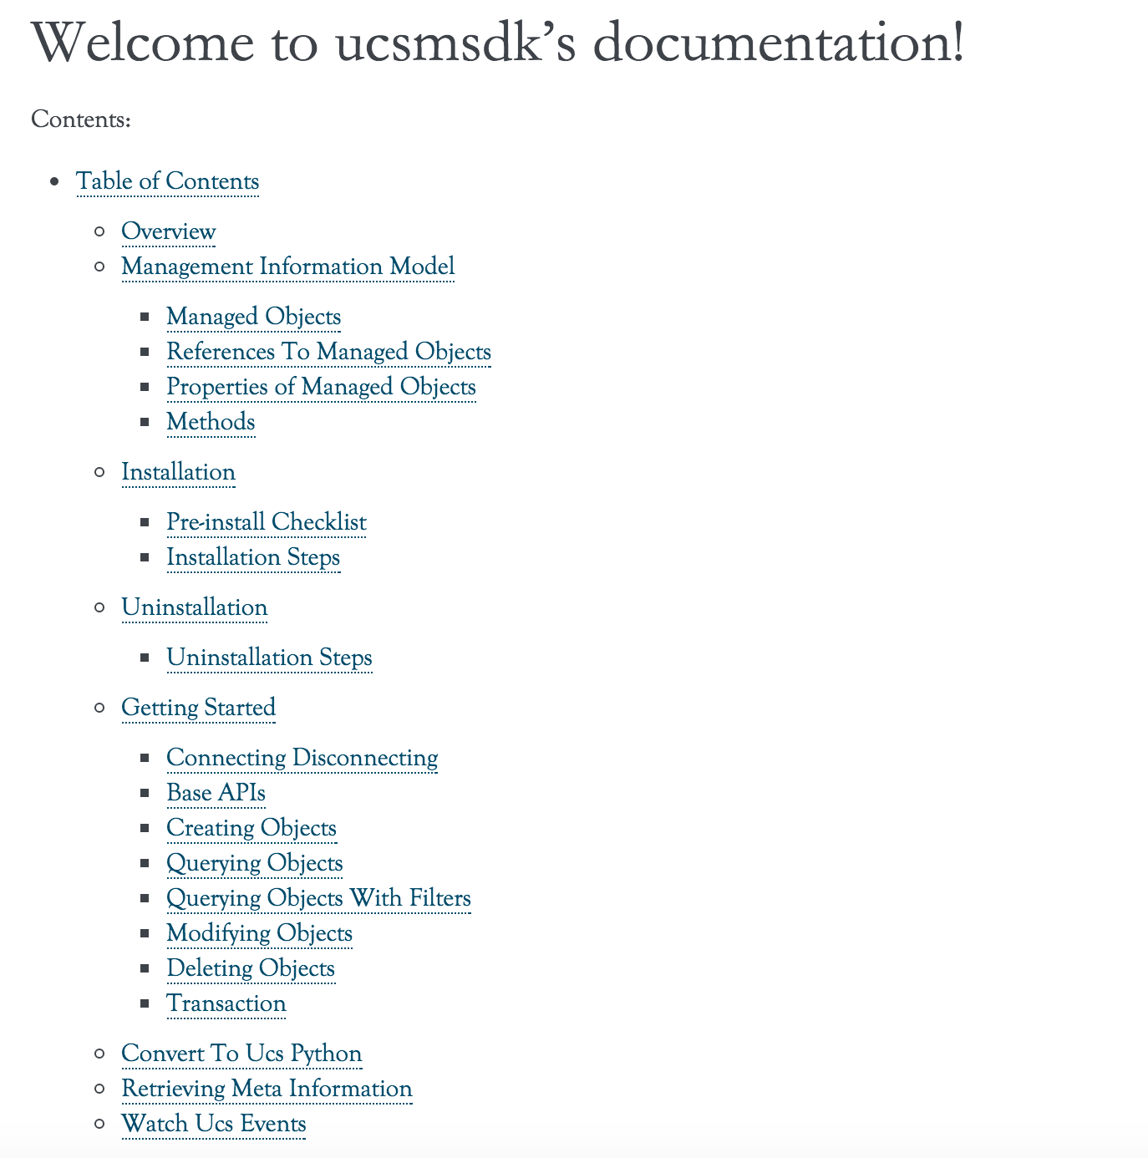
Documentation
https://ciscoucs.github.io/ucsmsdk_docs/

Slide 16
samples
Lot of samples available at
https://github.com/CiscoUcs/ucsmsdk_samples/

Slide 17
Community
We have an active slack channel. Invite yourself at https://ucspython.herokuapp.com/
Mailing list ucs-python@cisco.com
We really encourage filing issues/feature requests at https://github.com/CiscoUcs/ucsmsdk/issues

Slide 18
Q&A

